Slide 1
Sprite Ordering and Camera culling
Personal Research

Slide 2

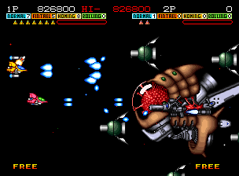
Intro to the problem: Sprite ordering

Slide 3
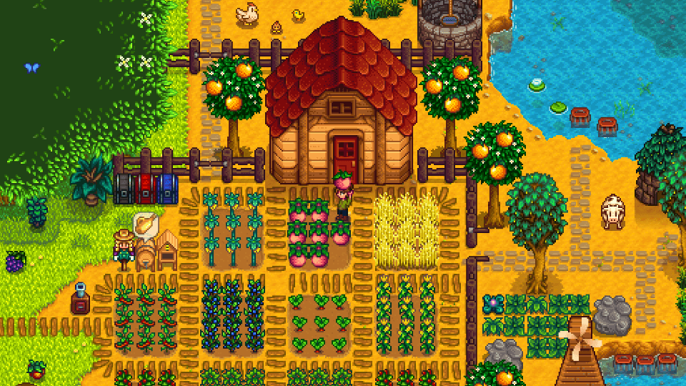

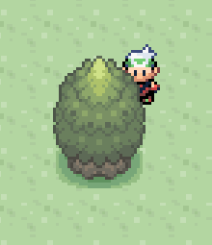
Intro to the problem: Sprite ordering

Slide 4
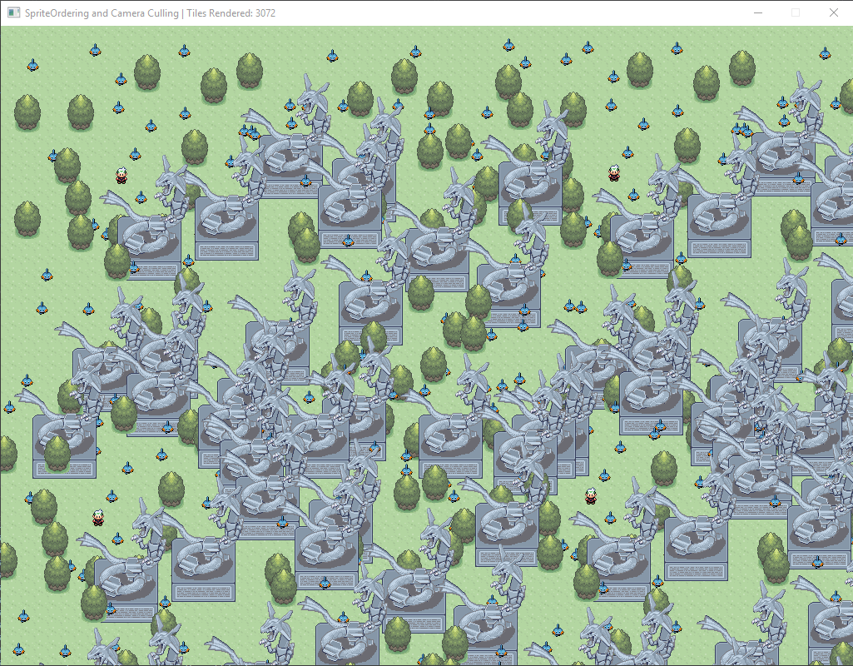
Intro to the problem: Camera culling

Slide 5
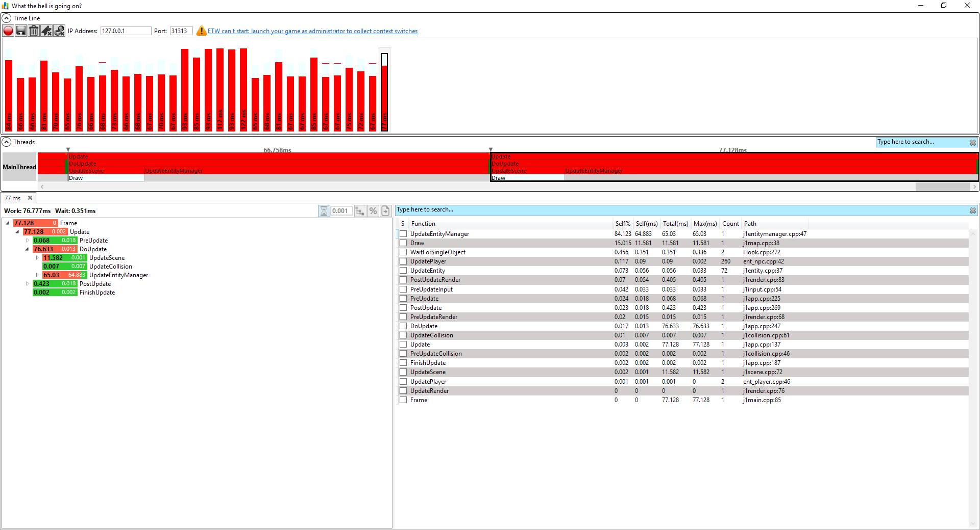
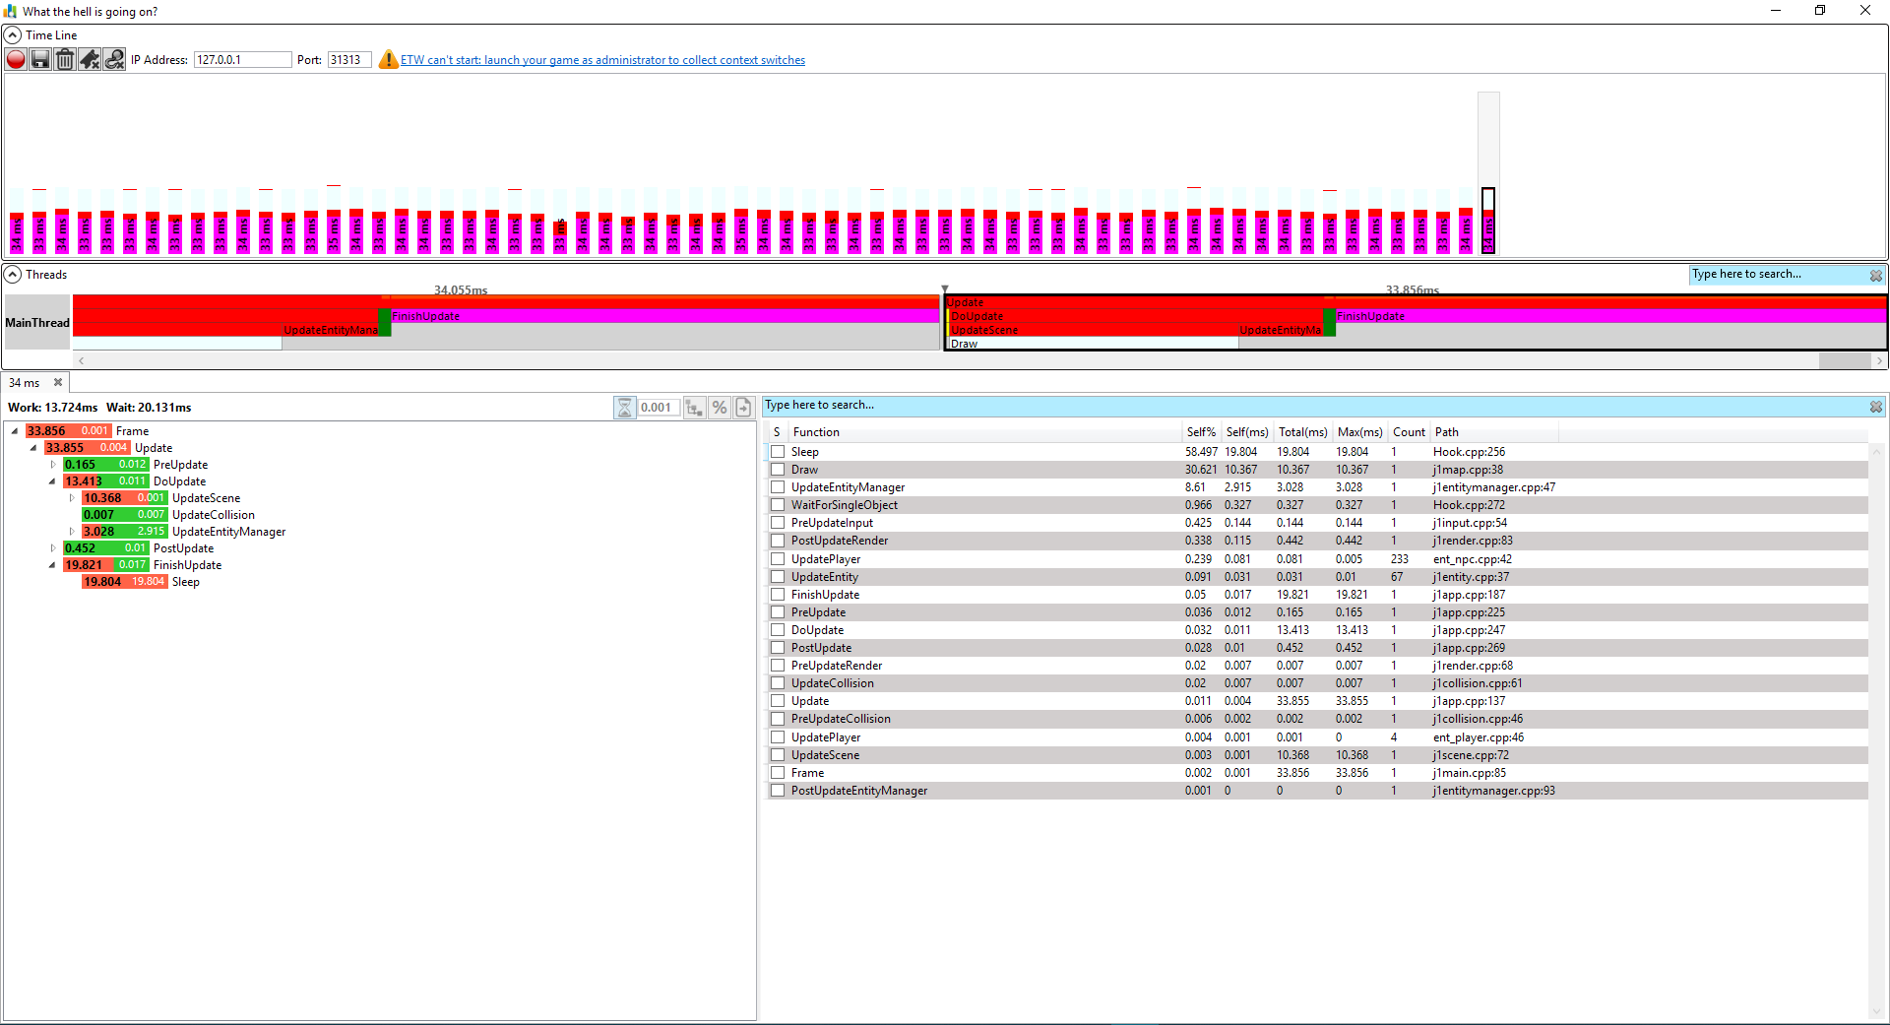
Intro to the problem: Camera culling
Without
With

Slide 6
Different approaches

Slide 7
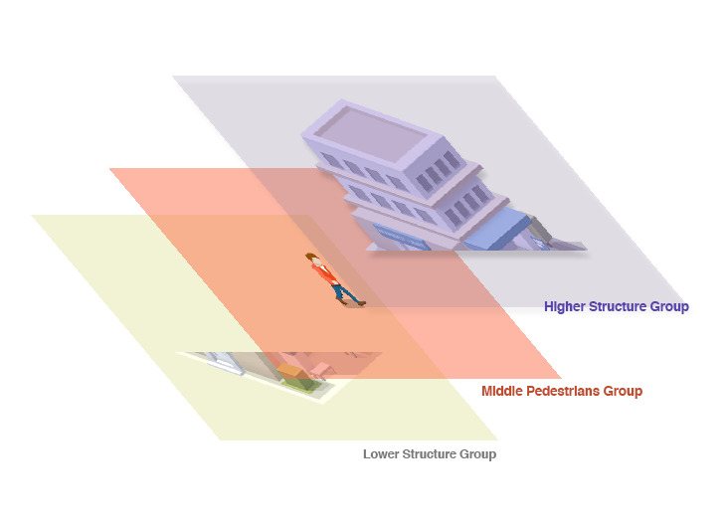
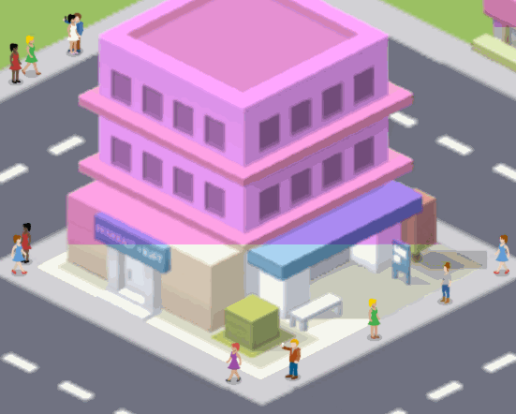
Cut Sprites
Notes:
Juegos bastante estáticos
Pocos recursos
Sistema bastante limitado

Slide 8


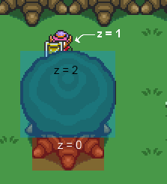
Cut Sprites

Slide 9

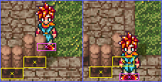
Sorting layers: By position

Slide 10
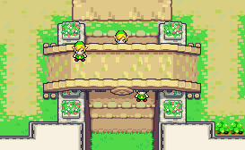
Sorting layers: Colliders

Slide 11
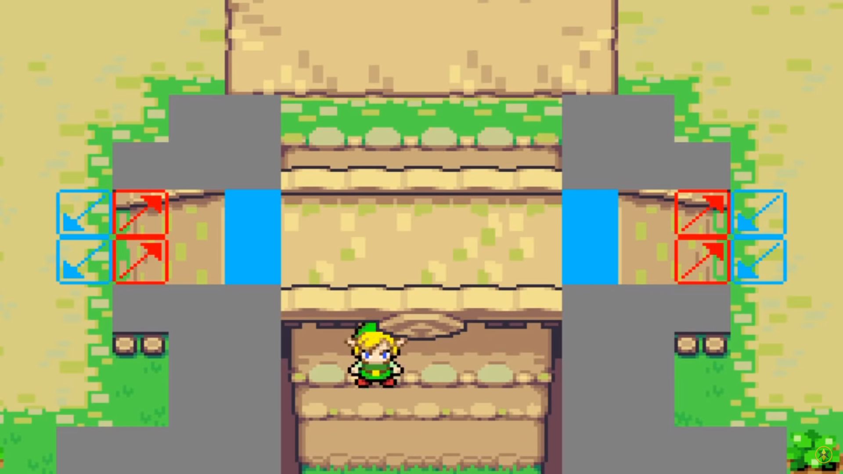
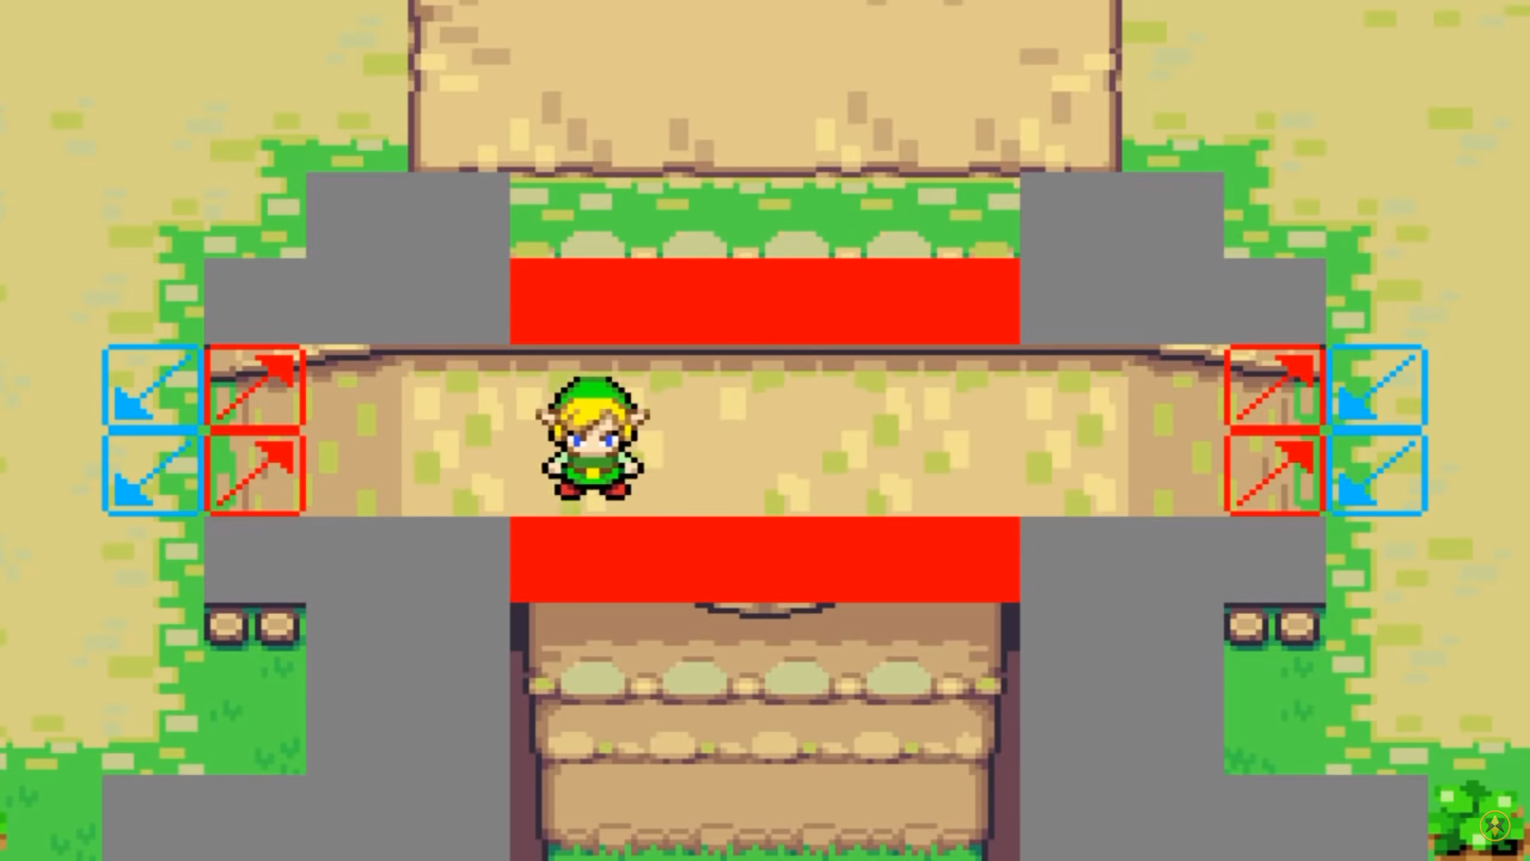
Sorting layers: Colliders
@Guinxu https://youtu.be/eMMnaUmWtnw?t=85

Slide 12
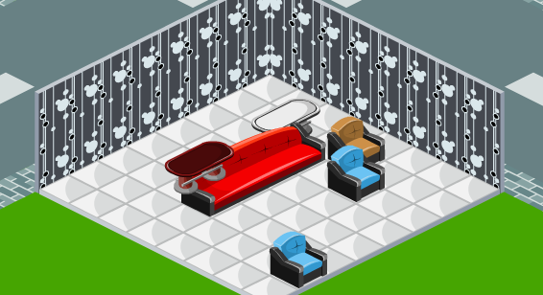
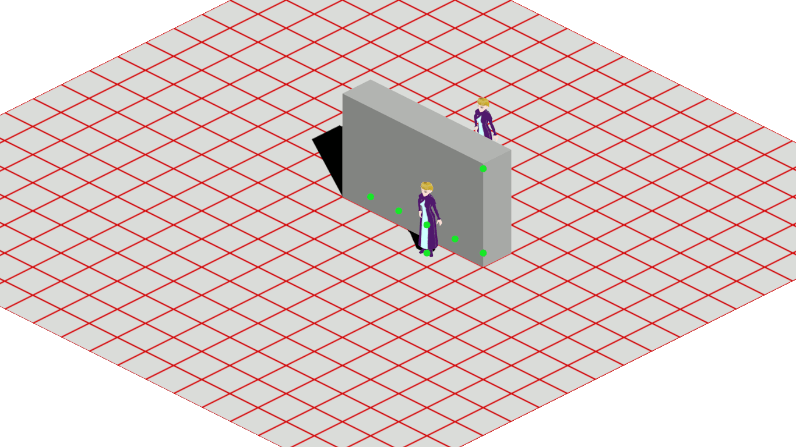
Sorting layers: 3D

Slide 13
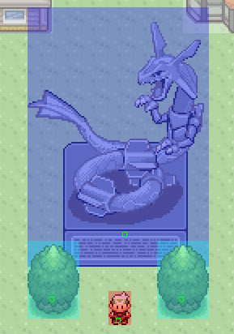
Selected approach
Sorting by Y position
Pivot
Static entities
Tiled implementation

Slide 14
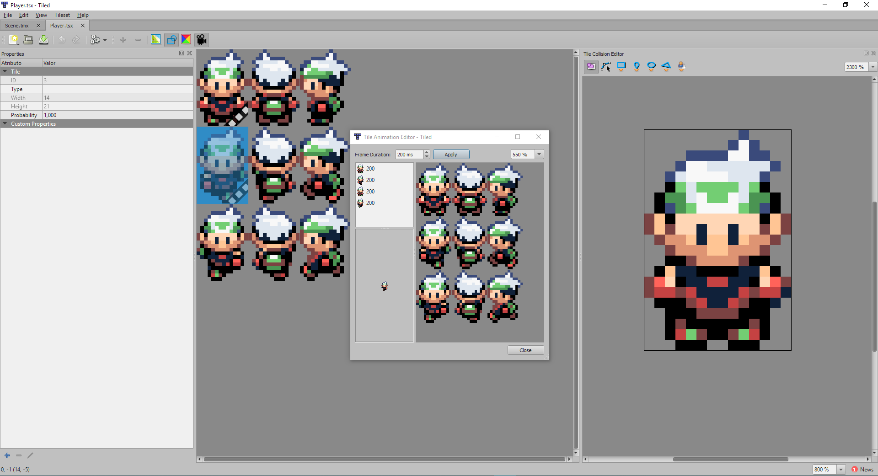
Working with Tiled: Dynamic entities
Easy to edit
XML export
Information
Variables
Animations
Colliders
Integrated in base code

Slide 15
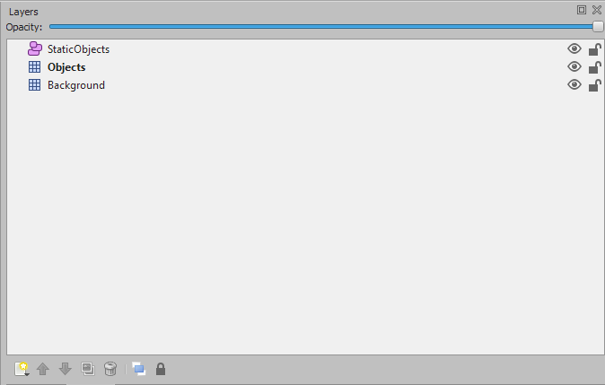
Working with Tiled: Static entities
3 layers
Background
Objects(Paint)
Objects(Colliders)

Slide 16
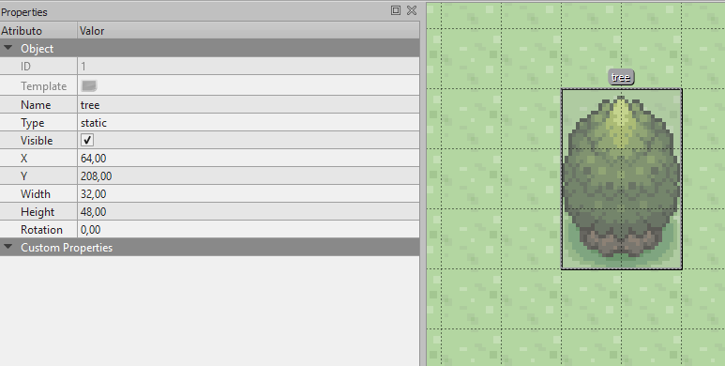
Working with Tiled: Static entities
Name
Type

Slide 17
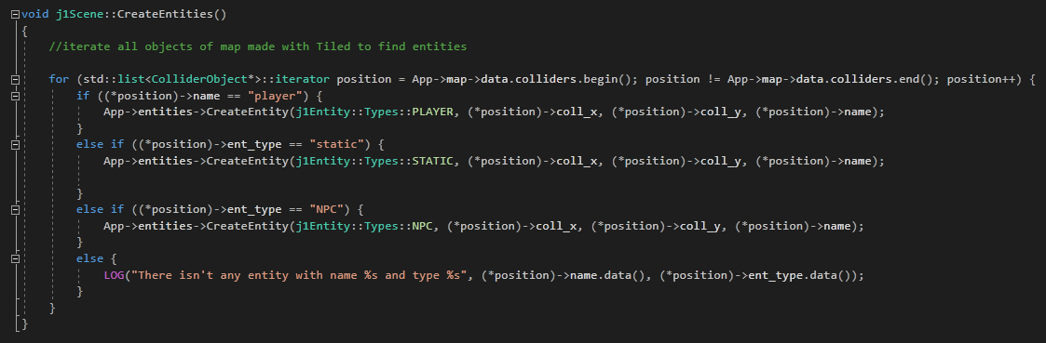
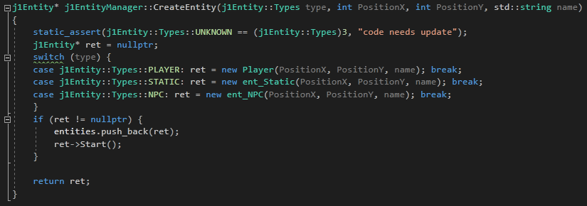
Working with Tiled: Static entities

Slide 18
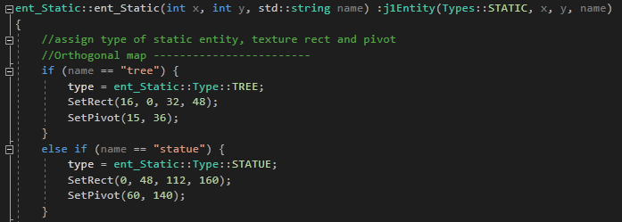
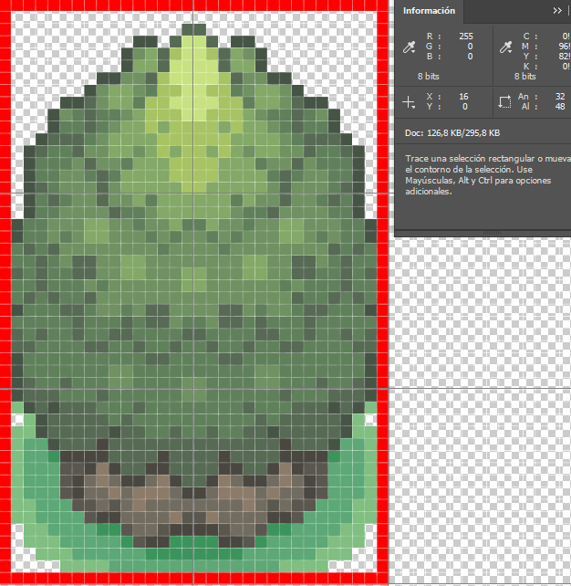
Working with Tiled: Static entities

Slide 19
TODO 1: Create IsOnCamera function
Returns true if something is on camera and false if it’s not
Not only a position, also a width and height
Camera moves inverse of other entities, change its sign
Scale is important. Use 1, 2 and 3 to zoom in
You can use SDL_HasIntersection(SDL_Rect1, SDL_Rect2)
Make use of const

Slide 20
TODO 2: Use IsOnCamera to blit map
Transform tiles to pixels
Use width and height of tile map
Move with arrows and check all is rendering well
Check in title the number of the tiles that are rendering

Slide 21
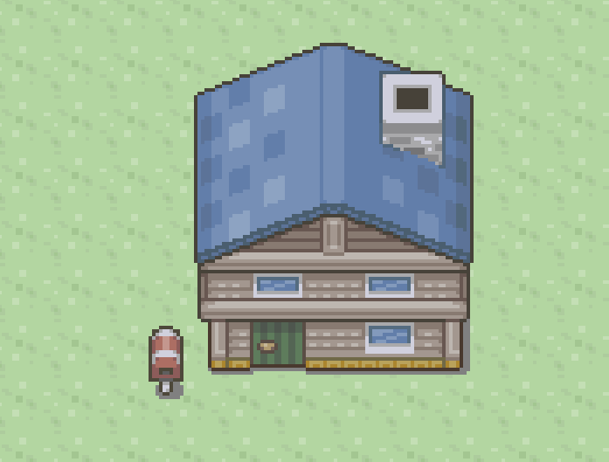
TODO 3: Create a post in Tiled and integrate it in code
Remember name and type
Use Ctrl to create objects that fits in tiles
Texture rect (0, 0, 16, 32)
Pivot (8, 15)

Slide 22
TODO 4: Save entities that are on camera
Draw_entities is a vector to draw entities, push back only entities on camera
Iterate draw_entities
Move draw functions from main entities iteration to draw_entities iteration

Slide 23
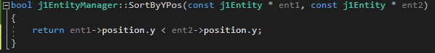
TODO 5: Sorting entities
Std::sort(first_iterator, last_iterator, function comparation)
SortByYPos
Sort only draw_entities
Sort before Draw()

Slide 24

TODO 6: Use pivot position
Sort entities by pivot position
Pivot is a local position
pivot.y position

Slide 25
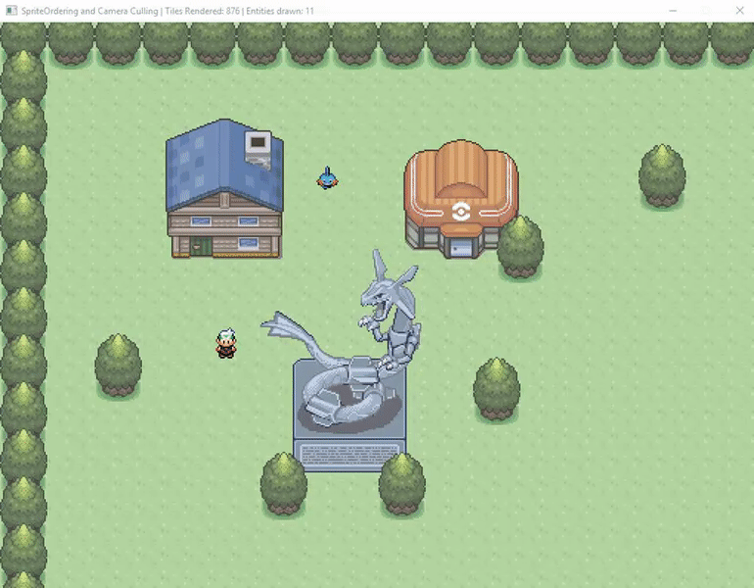
Congratulations

Slide 26
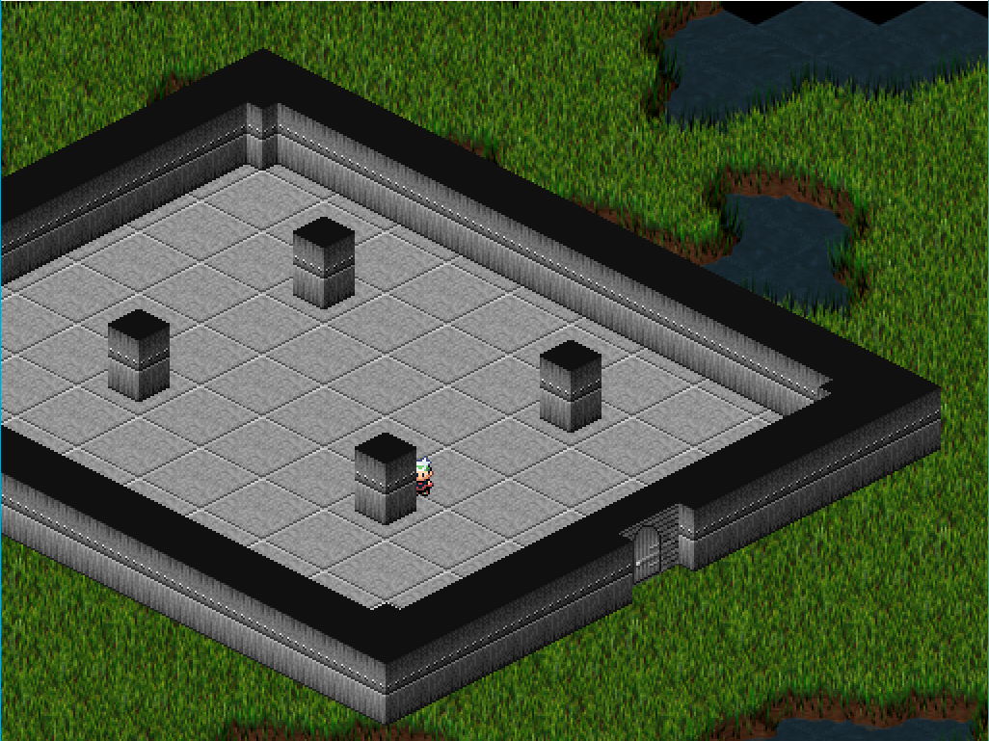
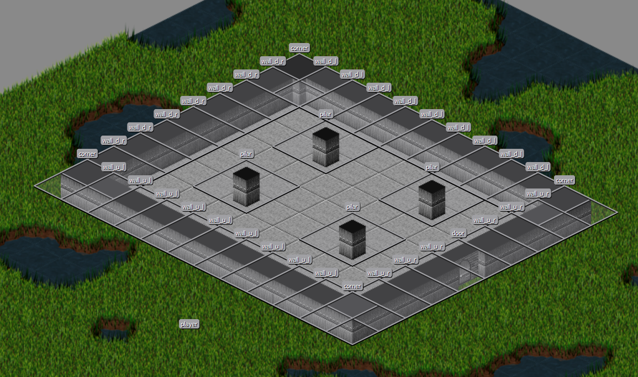
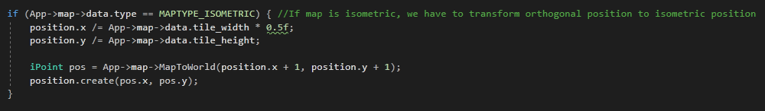
Push F4 to load an isometric map

Slide 27
Improvements
Textures are expensive to load -> id
Sorting method heavy:
https://brilliant.org/wiki/sorting-algorithms/
https://www.geeksforgeeks.org/sorting-algorithms/
Quadtree
Don’t iterate all map, only from camera position to camera position plus viewport size
Save all static entities in a xml file and load it

Slide 28

Thank you for your attention
Github: christt105
Contact: christt105@gmail.com

